Slide 1
Use of crop-soil-atmosphere dynamic models for (sub-)optimal irrigation management
Raphael Linker
Associate Professor
Division of Environmental, Water and Agricultural Engineering
Faculty of Civil and Environmental Engineering
Technion – Israel Institute of Technology
Haifa

Slide 2
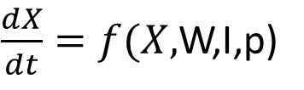
Model-based (sub-) optimal irrigation scheduling (single crop)
Initial conditions
Dynamic model
Crop development
/yield
$\frac{dX}{dt}=f(X,$W,I,p)
Weather
Irrigation
Prices
Quotas
Operational constraints
Objective
Soil characteristics
Crop parameters
Optimization tool

Slide 3
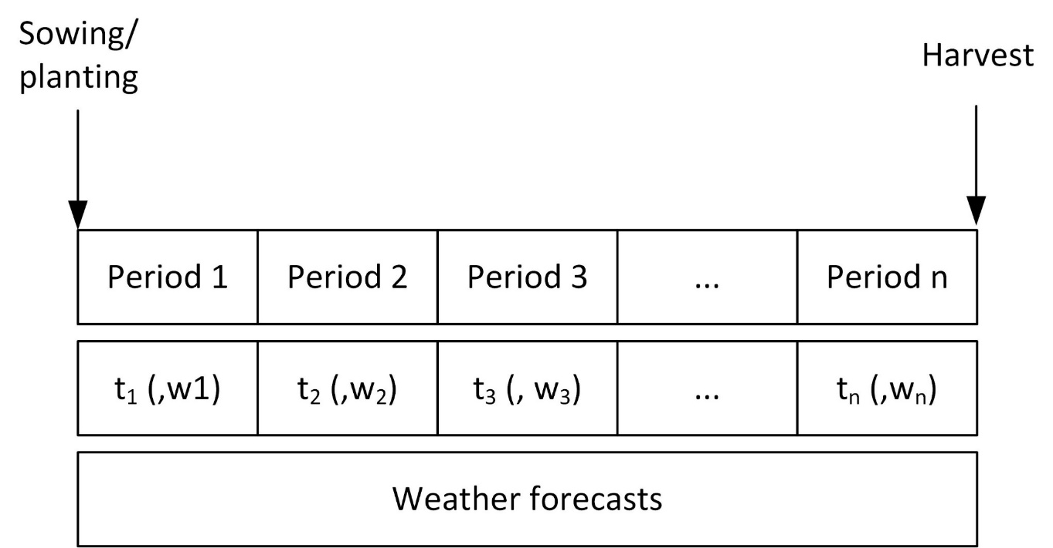
Model-based (sub-) optimal irrigation scheduling (single crop)
The optimization can be performed efficiently by defining as decision variables irrigation thresholds at which irrigation is triggered
What to optimize? Maximize yield; marginal yield; water use efficiency; profit; …?

Slide 4
Model-based (sub-) optimal irrigation scheduling (single crop)
The optimization can be performed efficiently by defining as decision variables irrigation thresholds at which irrigation is triggered
Find (t₁, t₂, … t_{n} (,w₁, w₂, … w_{n}))
such that
(-yield, total irrigation) minimum
What to optimize? Multi-objective optimization: Maximize yield and minimize irrigation

Slide 5
Model-based (sub-) optimal irrigation scheduling (single crop)
What to optimize? Multi-objective optimization: Maximize yield and minimize irrigation
t₁, t₂, …, t_{n}
Irrigation on days
10
25
30
…

Slide 6
Model-based (sub-) optimal irrigation scheduling (single crop)
What to optimize? Multi-objective optimization: Maximize yield and minimize irrigation
Quadratic approximation: Y*=f(I*)

Slide 7
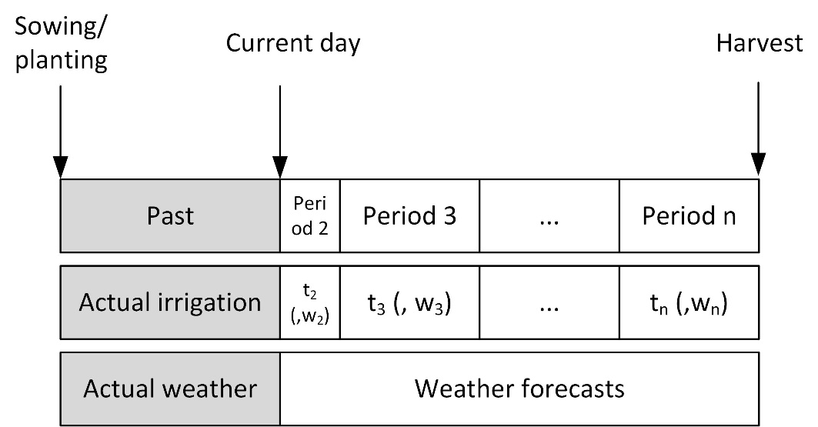
Model-based (sub-) optimal irrigation scheduling (single crop)
The optimization can be repeated during the season to account for the imperfectness of the weather forecasts

Slide 8
Extensions:
Optimal allocation of land and/or water between several crops
Delineation of management zones (drip irrigation)

Slide 9
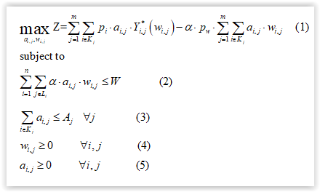
Formalism for optimal crop selection and water allocation
Assumptions:
n crops
m fields (soil areas)
Weather forecasts/historical weather
Prices for crops (p_{i}) and water (p_{w})
Operational constrains (water quotas, minimal yield, …)
n*m water productivity functions (Y*_{i,j}(w_{i,j})) determined by single-crop multi-objective optimization
Decision variables
a_{i,j} : Area of soil j allocated to crop i
w_{i,j} : Amount of water allocated to crop i cultivated on soil j

Slide 10
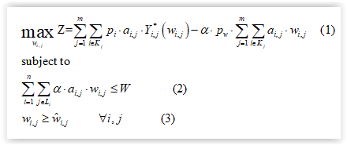
Formalism for optimal water allocation (during season or if cropping areas are fixed a priori)
Assumptions:
n crops
m fields (soil areas)
Weather forecasts/historical weather
Prices for crops (p_{i}) and water (p_{w})
Operational constrains (water quotas, minimal yield, …)
n*m water productivity functions (f_{i,j}) determined by single-crop multi-objective optimization
Recomputed using actual past weather and irrigation
Decision variables
w_{i,j} : Amount of water allocated to crop i cultivated on soil j

Slide 11
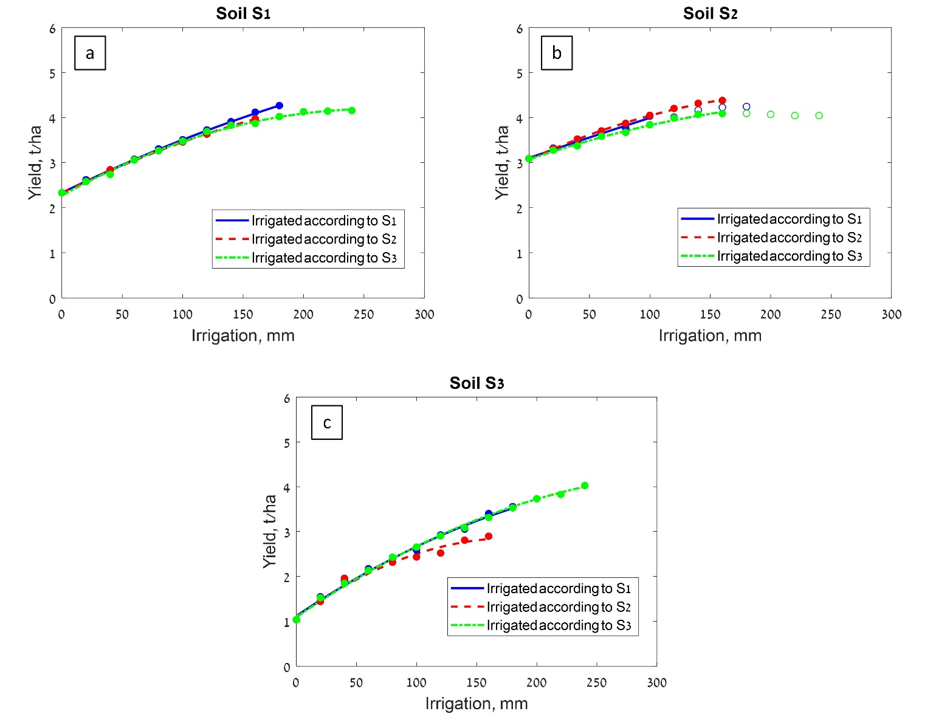
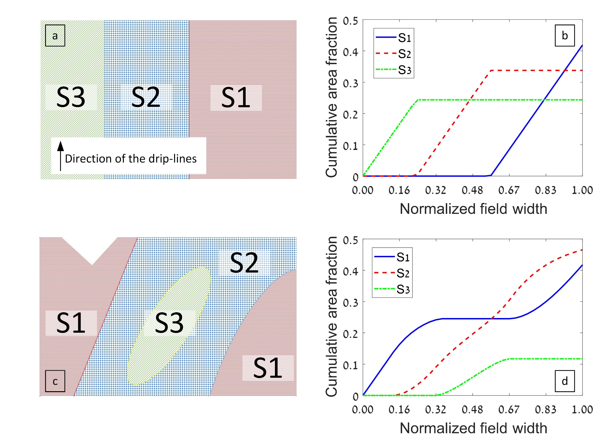
Formalism for optimal delineation of drip irrigation management zones
Direction of drip lines

Slide 12
Formalism for optimal delineation of drip irrigation management zones
Direction of drip lines

Slide 13
Formalism for optimal delineation of drip irrigation management zones

Slide 14
On-going work/Open issues
Stochastic optimization to deal with weather forecasts uncertainty
Data assimilation (use of in-season measurements to improve model predictions)

Slide 15
Stochastic optimization (Ensemble of N_{s} weather forecasts)
Implicit approach: Each forecast is used to solve a deterministic problem (independently) and some heuristic is used to select “the best” solution
Explicit one-stage approach: The optimization problems associated with the various forecasts are solved simultaneously, imposing the same set of optimal decisions for all forecasts:
Explicit two-stage approach: The optimization problems associated with the various forecasts are solved simultaneously, imposing that the first decision be the same for all forecasts:
$\max{\sum_{s=1}^{N_{s}}{p_{s}\left\{α⋅Y_{s}\left(d_{1},d_{2},d_{3},…,d_{n}\right)−\left[C\left(d_{1}\right)+C\left(d_{2}\right)+⋯+C\left(d_{n}\right)\right]\right\}}}$
$\max{\sum_{s=1}^{N_{s}}{p_{s}\left\{α⋅Y_{s}\left(d_{1},d_{2,s},d_{3,s},…,d_{n,s}\right)−\left[C\left(d_{1}\right)+C\left(d_{2,s}\right)+⋯+C\left(d_{n,s}\right)\right]\right\}}}$

Slide 16
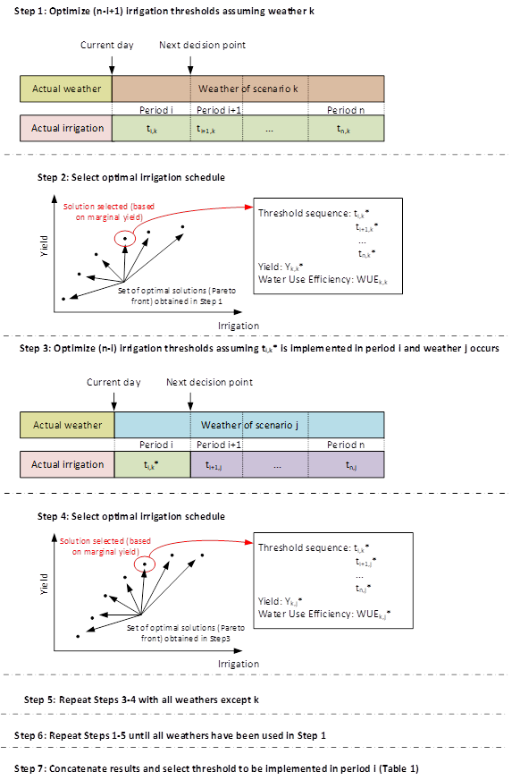
Stochastic optimization – Proposed scheme for multi-objective optimization inspired from “Explicit two-stage” approach

Slide 17
Stochastic optimization – Proposed scheme for multi-objective optimization inspired from “Explicit two-stage” approach
 | Water Use Efficiency
Weather used to determine threshold of Period 3 | Weather used to determine thresholds of Periods 4-6
 | 1965 | 1966 | 1967 | 1968 | 1969
1965 | 0.0781 | 0.0493 | 0.1632 | 0.0589 | 0.0756

Slide 18
Stochastic optimization – Proposed scheme for multi-objective optimization inspired from “Explicit two-stage” approach

Slide 19
Stochastic optimization – Proposed scheme for multi-objective optimization inspired from “Explicit two-stage” approach
 | Water Use Efficiency
Weather used to determine threshold of Period 3 | Weather used to determine thresholds of Periods 4-6
 | 1965 | 1966 | 1967 | 1968 | 1969
1965 | 0.0781 | 0.0493 | 0.1632 | 0.0589 | 0.0756
1966 | 0.0781 | 0.0566 | 0.1631 | 0.0733 | 0.0760
1967 | 0.0921 | 0.0531 | 0.1631 | 0.0668 | 0.0661
1968 | 0.0668 | 0.0565 | 0.1614 | 0.0589 | 0.0662
1969 | 0.0781 | 0.0565 | 0.2397 | 0.0667 | 0.0649

Slide 20
Stochastic optimization – Proposed scheme for multi-objective optimization inspired from “Explicit two-stage” approach
 | Water Use Efficiency
Weather used to determine threshold of Period 3 | Weather used to determine thresholds of Periods 4-6 |  |  |  |  | Median value
 | 1965 | 1966 | 1967 | 1968 | 1969
1965 | 0.0781 | 0.0493 | 0.1632 | 0.0589 | 0.0756 | 0.0756
1966 | 0.0781 | 0.0566 | 0.1631 | 0.0733 | 0.0760 | 0.0773
1967 | 0.0921 | 0.0531 | 0.1631 | 0.0668 | 0.0661 | 0.0668
1968 | 0.0668 | 0.0565 | 0.1614 | 0.0589 | 0.0662 | 0.0662
1969 | 0.0781 | 0.0565 | 0.2397 | 0.0667 | 0.0649 | 0.0667

Slide 21
Stochastic optimization – Proposed scheme for multi-objective optimization inspired from “Explicit two-stage” approach
Main open issues:
Which heuristic/metric should be used
Weight results according to forecasts probability

Slide 22
Data assimilation:
Models are imperfect. Measurements are also imperfect. How to reconcile the two? Who should you believe (more)?
How to improve the “prediction power” of the model?

Slide 23
Merci de votre attention
Thank you
תודה על ההקשבה

